Slide 1
Customer Behavior Analysis in Online Food Delivery
SQL Case Study
Jayesh Malviya
CX_138

Slide 2
Introduction
Objective:
Analyze customer behavior using SQL
Focus:
Revenue analysis
Customer activity
Gold membership impact

Slide 3
Dataset Overview
Tables
Users
Sales
Product
Goldusers_signup
Key columns
user_id
product_id
Price
created_date

Slide 4
Methodology & Approach
SQL Techniques Used:
Joins
Aggregations
CTEs
Window Functions
Approach:
Query → Analyze → Insight

Slide 5
SQL queries ->

Slide 6
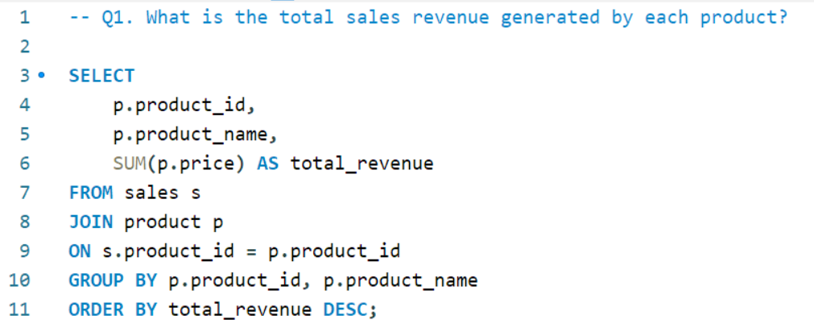
Q1

Slide 7
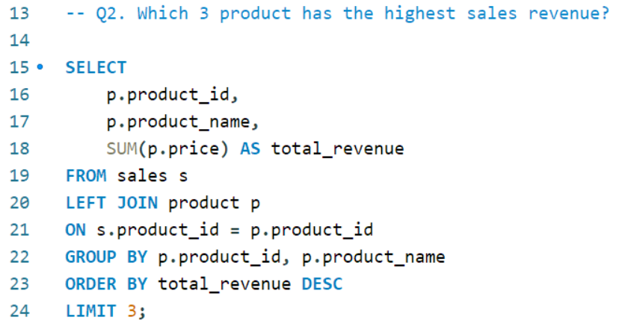
Q2

Slide 8
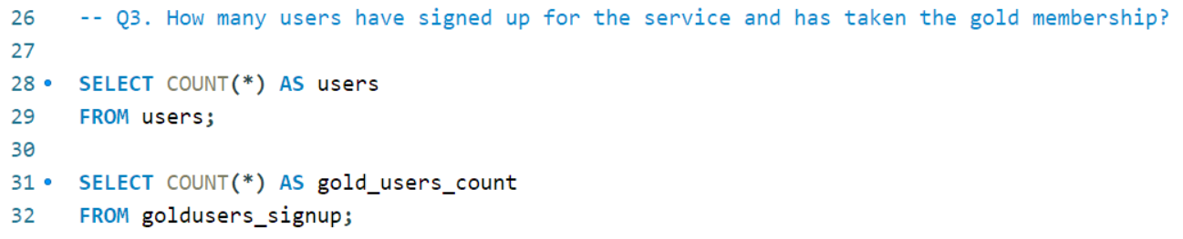
Q3

Slide 9
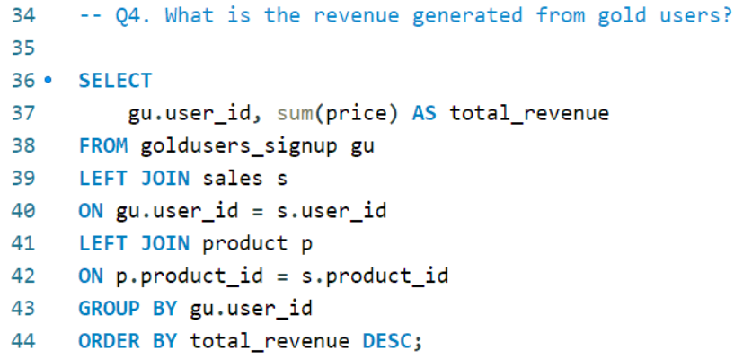
Q4

Slide 10
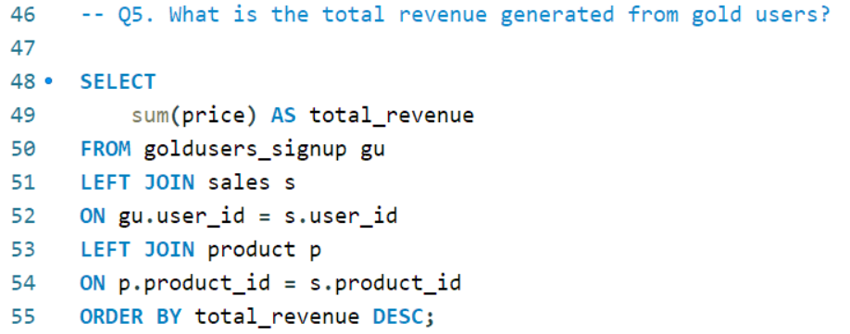
Q5

Slide 11
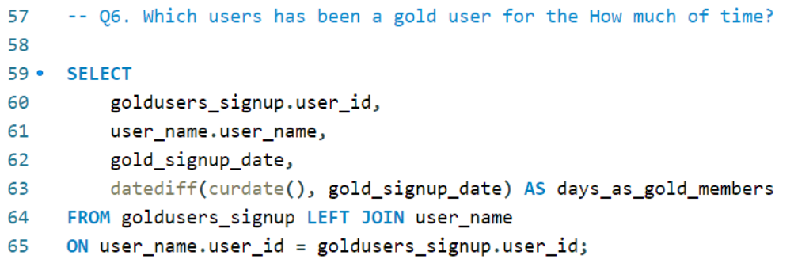
Q6

Slide 12
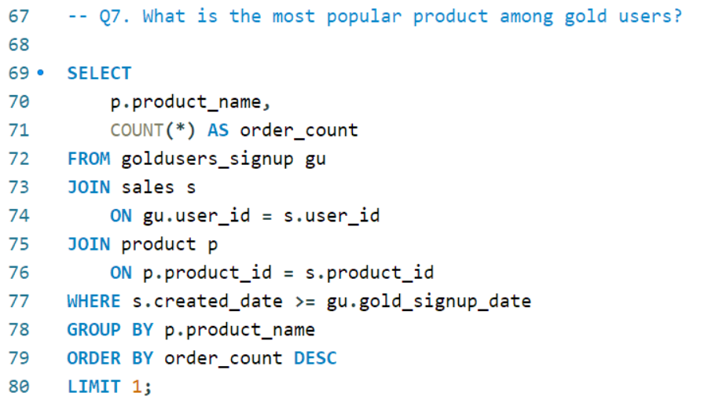
Q7

Slide 13
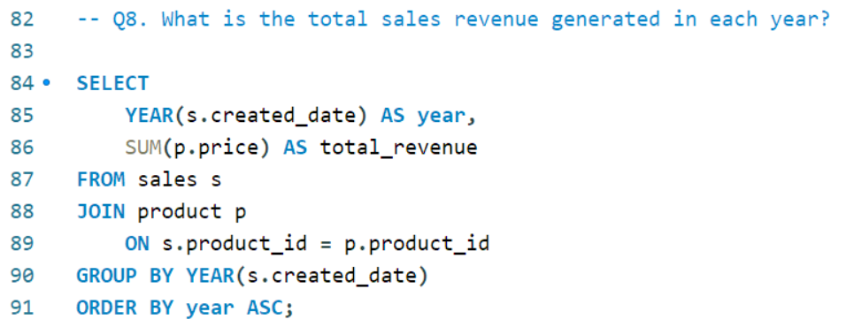
Q8

Slide 14
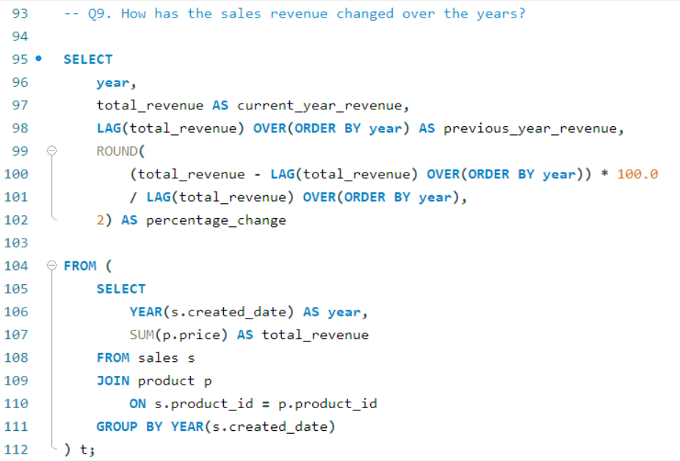
Q9

Slide 15
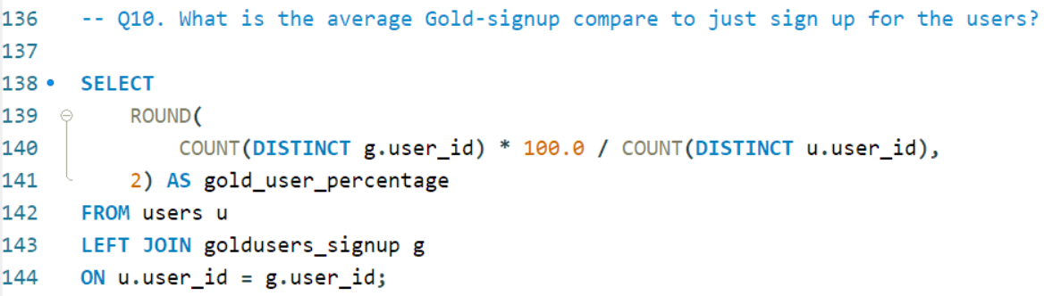
Q10

Slide 16
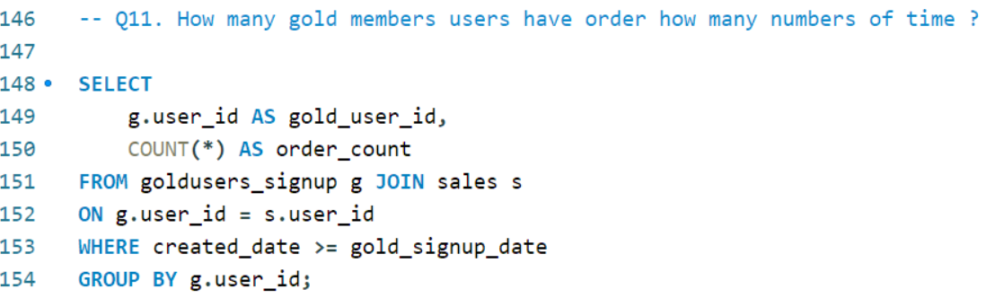
Q11

Slide 17
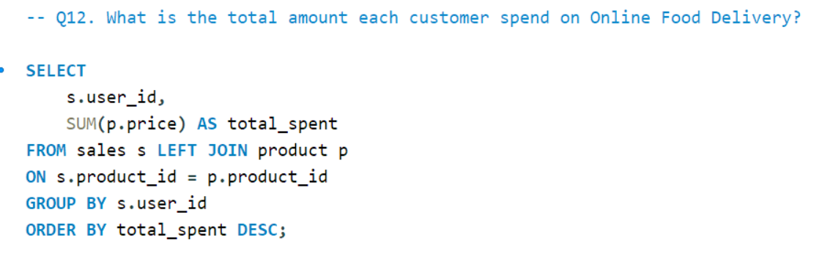
Q12

Slide 18
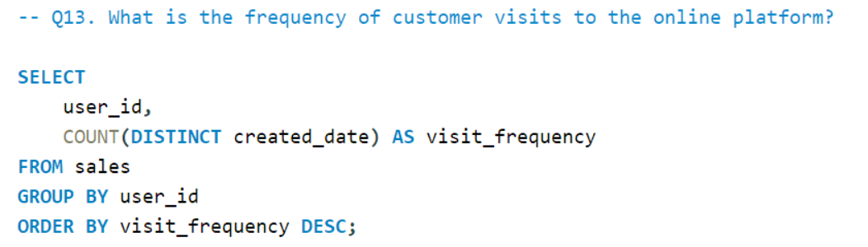
Q13

Slide 19
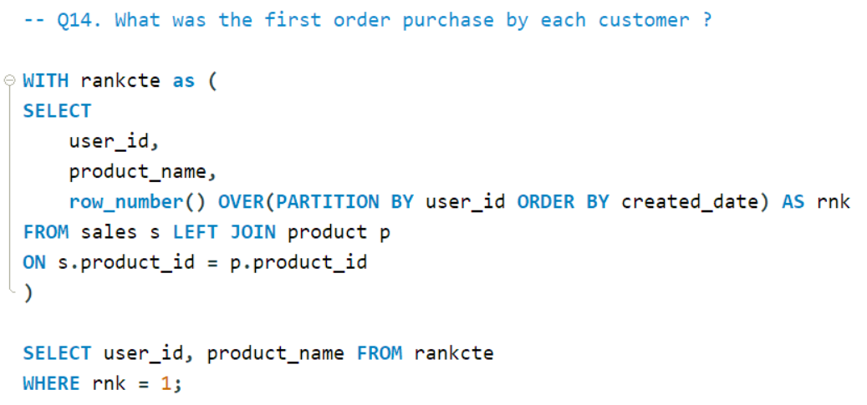
Q14

Slide 20
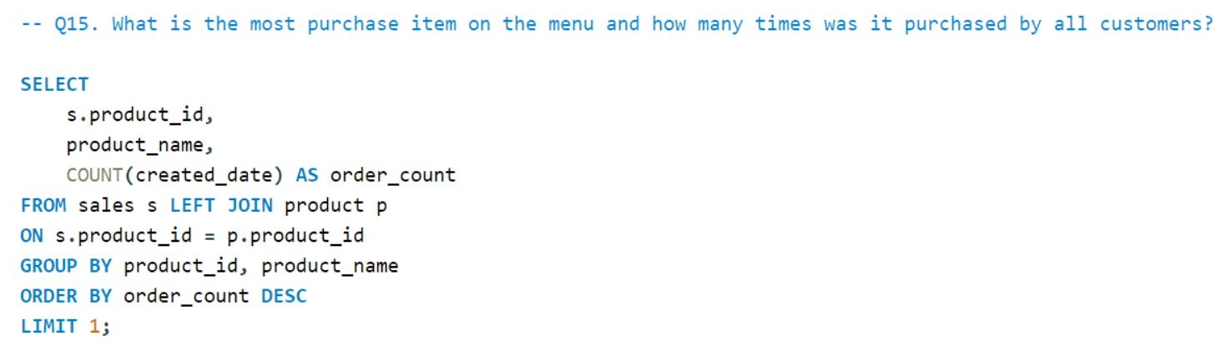
Q15

Slide 21
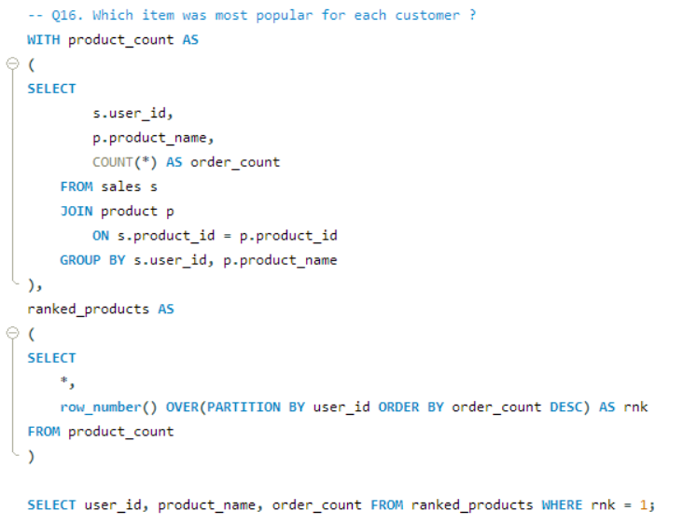
Q16

Slide 22
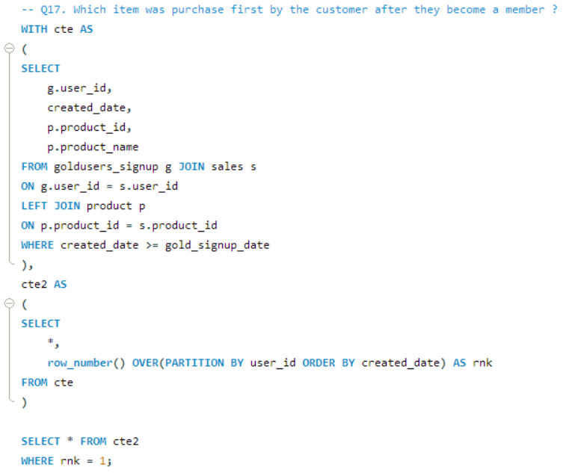
Q17

Slide 23
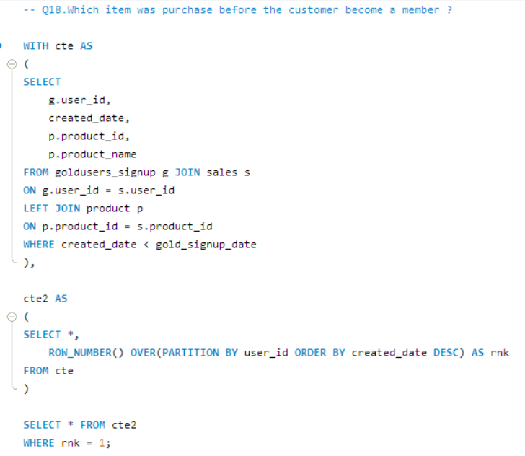
Q18

Slide 24
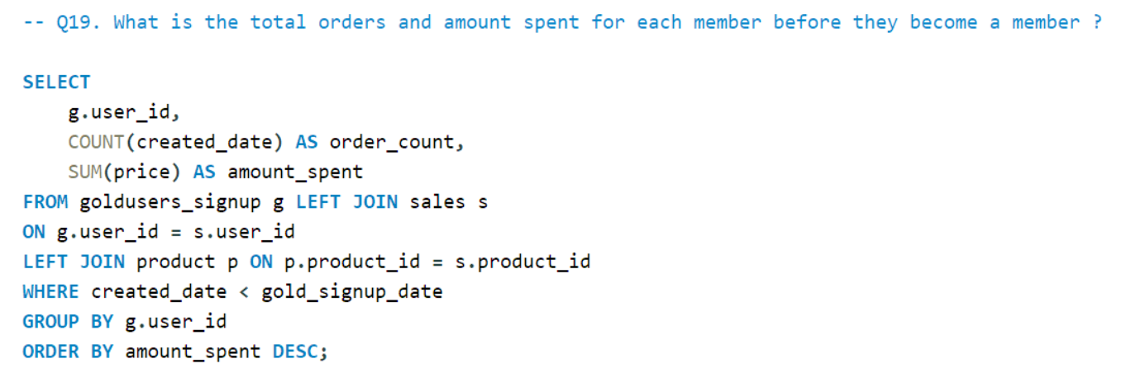
Q19

Slide 25
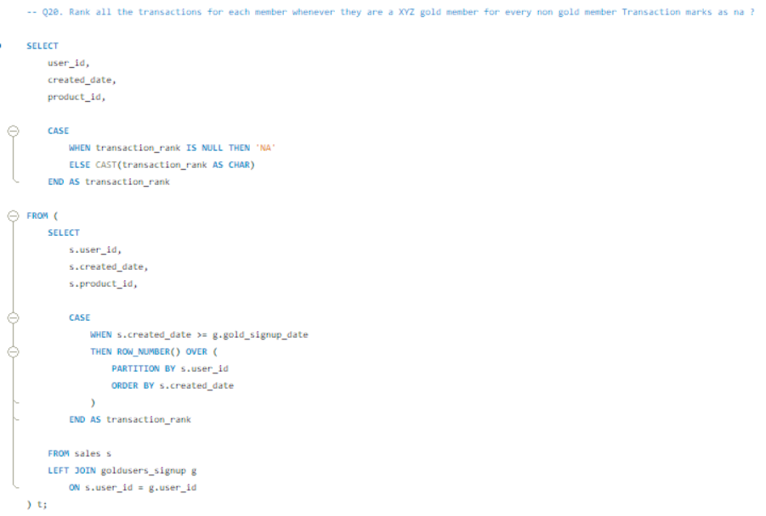
Q20

Slide 26
Final Insights & Conclusion
Key Insights
Gold users spend more
Engagement increases after membership
Few products drive majority revenue
Personalized behavior patterns exist
Recommendations
Promote gold membership
Target high-value users
Recommend products based on behavior

Slide 27
Thank you.

